Slide 1


PROJECT TITLE :BOOK RECOMMENDATION SYSTEM USING CHATBOT
Name of Student: AKTU Roll number:
Ankul Mishra 2300100100080
Under Supervision
Mr. Himanshu

Slide 2
OUTLINE:
Introduction
Objective
Data Flow Diagram
ER Diagram
Conclusion

Slide 3
INTRODUCTION:
AI chatbots simulate human-like conversation.
Built using IBM Watson Assistant for natural language understanding.
Deployed on a website via integration code.
Purpose: improve interaction and provide automated support.

Slide 4
OBJECTIVE:
To build an AI-powered chatbot for user queries.
Provide automated, 24/7 assistance.
Reduce human workload in customer support.
Improve user experience with quick and accurate replies.

Slide 5
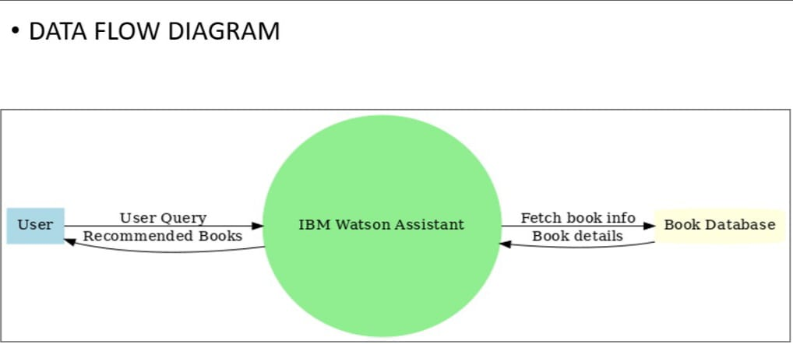
DATA FLOW DIAGRAM:

Slide 6
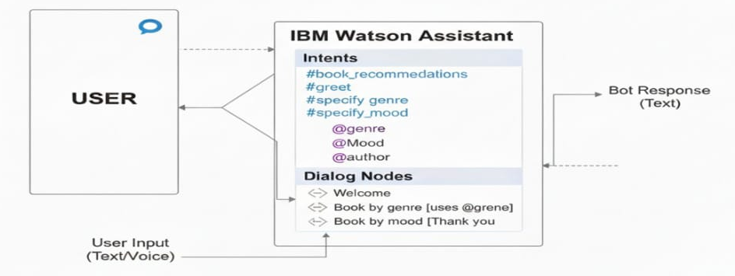
ER DIAGRAM:

Slide 7
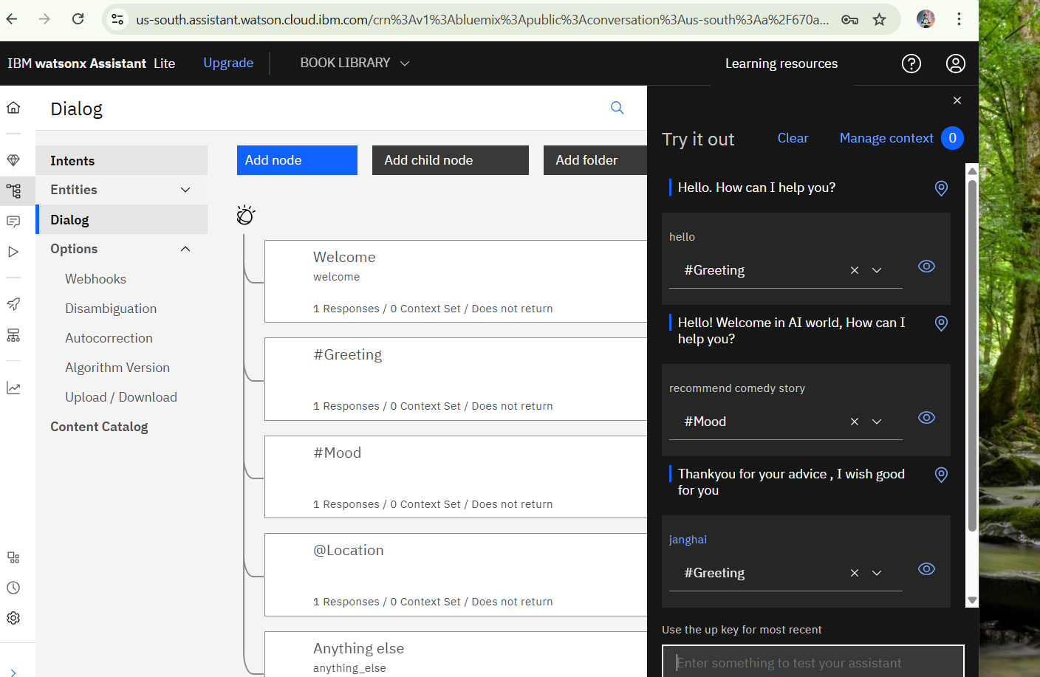

Slide 8
Conclusion:
Provides instant, accurate, and personalized recommendations.
Automates responses, reducing human workload.
Improves accessibility and efficiency in customer support.
Applicable in education, e-commerce, healthcare, and more

Slide 9
THANK YOU

